Slide 1
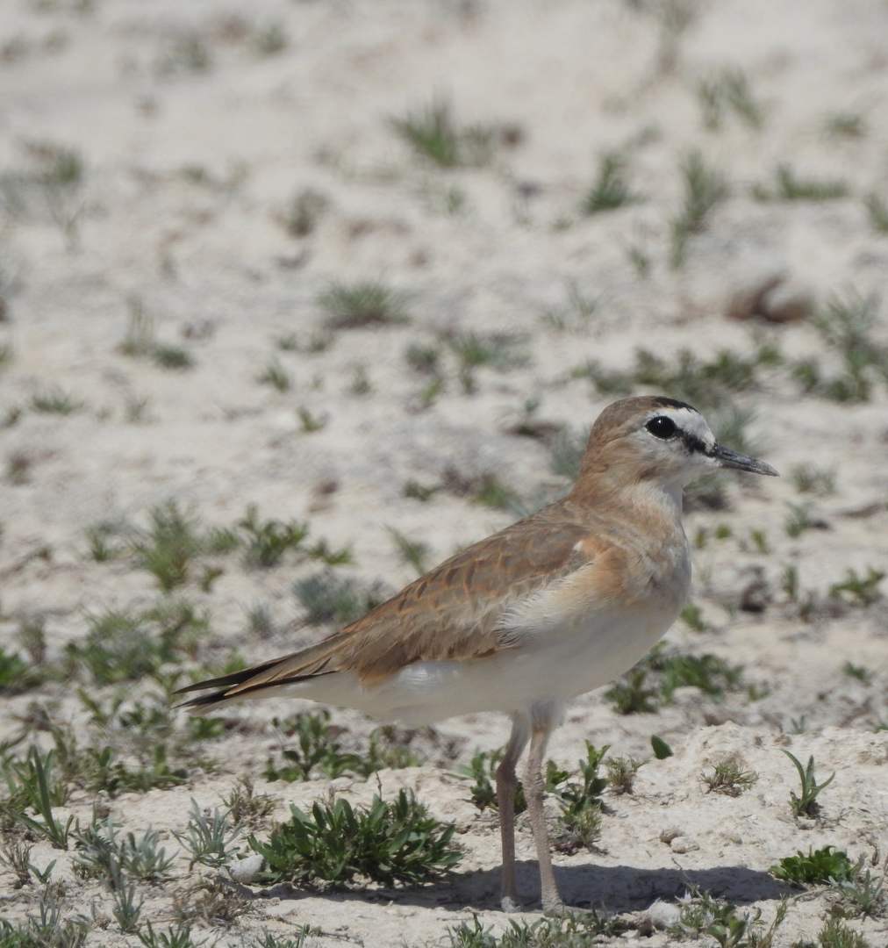

Multi-season occupancy models

Slide 2


Did they stay or did they go?
Year 1
Year 2
Year 3
?

Slide 3
Multi-season model
Occupancy of a patch can change between seasons
Occupancy of a patch cannot change within seasons
Season 1
Extinction
Season 2
Colonization
Season 3
ψ₁
ψ₂
ψ₃
ψ₁
p₁
Need closure to estimate detection!

Slide 4
Hierarchical study design
Local
Extinction/Colonization
2
1,2, …, K₂
1
1,2, …, K₁
2
1,2, …, K₂
1
1,2, …, K₁
T
1,2, …, K_{T}
T
1,2, …, K_{T}
Season
Survey
Detection history
101
000
110

Slide 5
Implicit dynamics model
Season 1
Season 2
Season 3
ψ₁
ψ₂
ψ₃
p₁
p₂
p₃
Detection history
101
000
110
Test Yourself! Write out the probability statements for the detection histories of each season
Season 1: Patch is occupied with detection of species in 1st and 3rd survey, but missed in 2nd
Season 2: Species not detected in all surveys but present OR patch unoccupied
Season 3: Patch occupied and detected in 1st and 2nd surveys but not the third
ψ₁ * p_{(1,1)} * (1 - p_{(1,2)}) * p_{(1,3)}
Colonization?
Extinction?
ψ₂ * (1 - p_{2,1)}) * (1 - p_{(2,2)}) * (1 - p_{(2,3)}) + (1 - ψ₂ )
ψ₃ * p_{(3,1)} * p_{(3,2)} * (1 - p_{(3,3})
Does not model colonization/extinction explicitly.

Slide 6
Explicit dynamics model
Change in occupancy from 1st season
ε = probability a currently occupied patch will be unoccupied in the next season (extinction)
1 - ε = probability a currently occupied patch remains occupied
γ = probability a currently unoccupied patch will be occupied in the next season (colonization)
1 - γ = probability a currently unocccupied patch will remain unoccupied
1 - ε₁
1 - ε₂
Occupied
ψ₁
ε₁
ε₂
Season 1
Season 2
Season 3
1 - ψ₁
γ₁
γ₂
1- γ₁
1- γ₂
Unoccupied

Slide 7
Explicit dynamics model
Test Yourself! Write out the probability statements for the detection history
Season 1
Season 2
Season 3
1 - ε₁
1 - ε₂
h = 101 000 110
Season 1:
Season 2:
Season 3:
Occupied
ψ₁
ε₁
ε₂
ψ₁ * p_{1,1} * (1 - p_{1,2}) * p_{1,3}
(1 - ε₁) + (1 - p_{2,1}) * (1 - p_{2,2}) * (1 - p_{2,3}) + (1 - ε₂) + ε₁ γ₂
1 - ψ₁
γ₁
γ₂
1- γ₁
1- γ₂
p_{3,1} * p_{3,2} * (1 - p_{3,3})
Unoccupied

Slide 8
Covariates
Modeled same as single season but with 2 new parameters
Detection
Occupancy
Colonization
Extinction

Slide 9
Assumptions
No unmodeled heterogeneity in any parameters
Occupancy constant across surveys in a season (closure within seasons)
Detection of organism independent from detection history
Organism never falsely detected (no false positives)

Slide 10
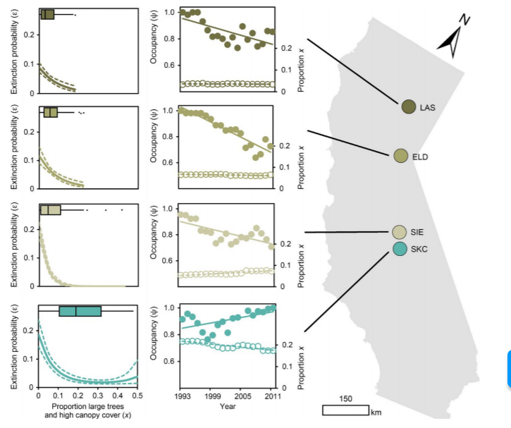
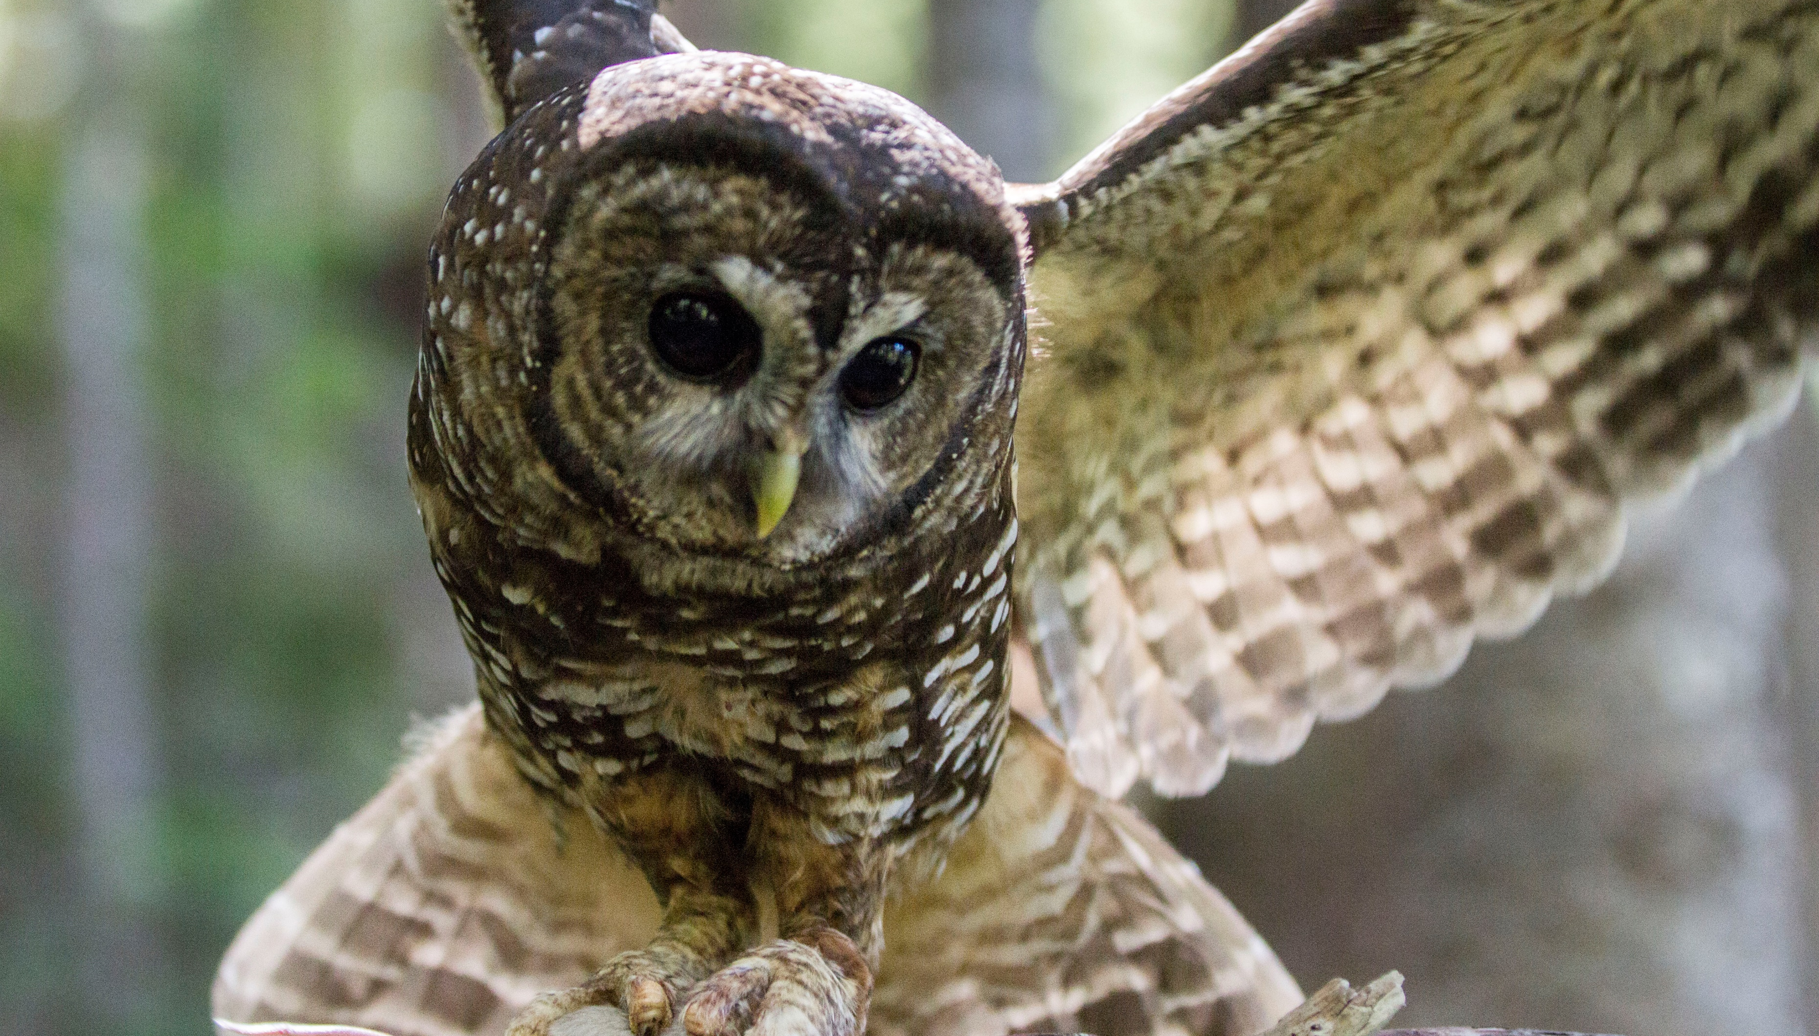
Real world example
Jones et al. 2018. Divers. and Dist. 24(3).

